Slide 1
Usability questions: How to ask effective questions

Slide 2
Introduction
Asking the right questions in usability testing is vital.
In this chapter, we share examples of usability testing questions to ask
before,
during,
and after the test, and best practices to keep in mind to get effective results.

Slide 3
So..
There are two ways to gather info with a usability test: observing participants completing pre-defined tasks, and asking participants usability testing questions.

Slide 4
WHY
Asking questions can prompt a user to reflect on certain parts of the user experience and voice their feedback.
Since finding participants is always a challenge, every test counts.

Slide 5
1: Questions to ask before the usability test
Finding participants for user testing can be tough. So it’s tempting to take people up on their offer to participate as soon as you find them.
But remember: not all test participants will give you equally relevant results. One usability testing best practice is to test people who resemble your target audience, as this will give you an accurate idea of how to improve your design from real potential users.

Slide 6
Types of questions to be asked before testing
To find out more about your participants, you have two types of user testing questions at your disposal:
1. demographic questions and
2. background questions.

Slide 7
Demographic questions
Demographic info gives your results more context, allowing you to spot usability trends across different demographics, ages, nationalities, genders, income groups, etc.
Ask carefully though—demographic questions can touch on sensitive topics for some people. Here’s a few examples of well-worded demographic questions to ask as part of your user research.

Slide 8
Example - demographic
What age group are you in? 18-24, 25-30, 31-40, etc.
How do you describe your gender?
What’s your relationship status?
What’s your household income? (Provide ranges as options)
How do you describe your ethnicity?

Slide 9
Background questions
Apart from finding out demographic info, it’s also smart to ask some screening questions related to people’s product habits and preferences.
If someone’s using your competitors’ products, for example, you should take this into account when analyzing their results. This kind of info is also useful when thinking of post-test questions to ask specific people.

Slide 10
Background questions
On the other hand, a participant who’s completely new to your product might spot usability issues in your design that are intuitive to long-time users.
So it’s important to find out before you start the testing session.

Slide 11
Background Questions Example
How often do you use --- this type of app----?
How often do you use ecommerce site?
How often do you use some app??
Which features do you use most?
How experienced/comfortable are you with using an application to do [X action]?
What type of payment system do you use to do pay online ?
Have you used any products in the [X industry] before?
How often do you use [X type of product] to do [X action]?
What device do you normally use for listening music?

Slide 12
Contd…
By deploying the right demographic and background questions pre-test, you make sure you choose the right test participants, and you’ll have more information with which to analyze your results afterwards.
This can help explain potential anomalies in results, and also gives you info to make your design more accessible to a wider variety of people.

Slide 13
2 : Questions to ask during the usability test
Asking questions during a usability test helps pinpoint design issues by probing a little deeper. However, it’s also important not to ask too many questions so the participant can complete the test with minimal distraction.
To avoid having to rely on questions too much, make sure you write some great usability tasks.

Slide 14
Also….
The number one rule of usability test questions is no leading questions. A leading question influences that participant to respond in a certain way, skewing your results. Instead, you should carefully word your questions so they’re neutral and open…

Slide 15
Wrong Question
What made completing this task a good experience?
How simple and clean was the interface?
Was the language in the mobile app clear and straightforward?
“By using words like ‘simple’ and ‘clear,’ you can unintentionally plant ideas into the participant’s head. So avoid adjectives whenever possible, and phrase questions in a way that invites participants to share their thoughts openly.”

Slide 16
Example questions to be asked during usability test
How was your experience completing this task?
What do you think of the user interface?
How is the language used on this page?
What’s your opinion on the way features and information are laid out?
How did you find navigating to [X] page?
Which parts of the website do you use most often?
What did you think of the explanations on the page?

Slide 17
More questions:
What do you think [feature] is trying to communicate to you?
How have you seen [content] presented in other diagrams, domains, or standards?
Based on the previous task, how would you prefer to do this action instead?
Thinking about how your team likes to work, how would [feature] change the way you work, if at all?

Slide 18
3 : Questions to ask after the usability test
Once the participant has made it to the end, it’s a good time to ask broader follow-up questions about their overall experience. Since you’ve already asked about specific design details as they came across them, these questions can be more open-ended and could even include opportunities for the user to suggest improvements.

Slide 19
Examples(Qualitative)
What did you think of the app/website overall?
What did you like the most/least about this product? Why?
How would you describe your experience with this product?
Would you use such a product to do [X activity] in real life?
What features would make you more likely to use this product more?

Slide 20
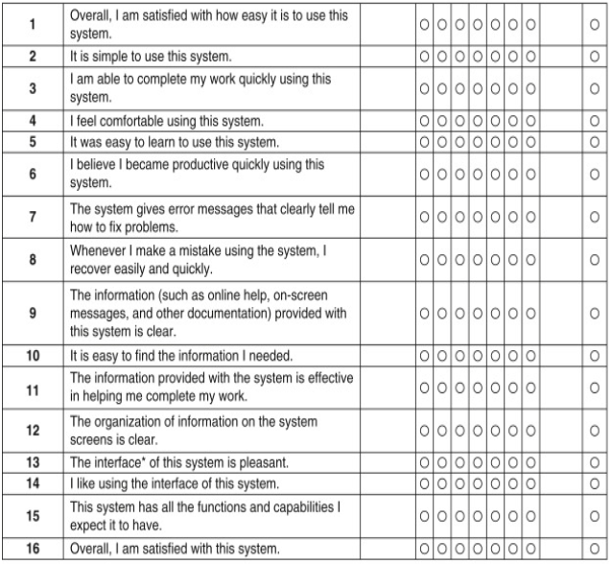
Examples (Quantitative)

Slide 21
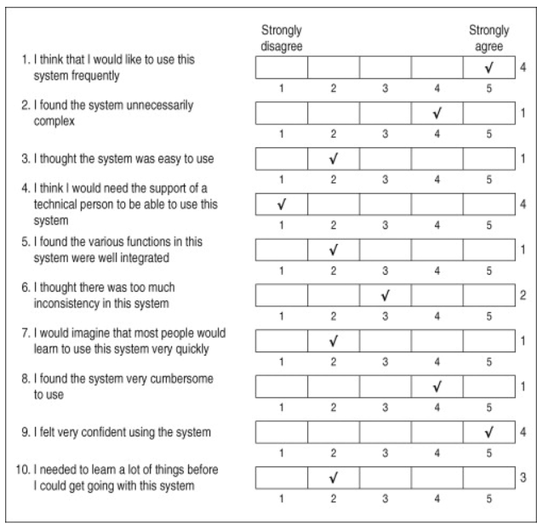
Example Quantitative

Slide 22
Ask better questions, get more useful results
Conducting usability tests can take considerable time and effort—and you only have a limited window to probe each user’s thoughts on your user experience design. Asking the right questions at the right time lets you squeeze as much juice out of each test as possible.
Get as much background info as you need, practice your wording to avoid leading questions, and think about the type of data you want to come away with at the end. Questions are one of the main techniques UX researchers have to interact with real users—so use them wisely.

